Slide 1

Machine Learning (19CSE305)
Term Project: Group 8
Project Title: Box Office Prediction
Aashutosh G Vyas – BL.EN.U5CSE19002
Gayatri S Sannala – BL.EN.U5CSE19045
K. V. G. Rohith – BL.EN.U5CSE19073
Lavanya Shirisha M. – BL.EN.U5CSE19076
Vinamratha Pattar - BL.EN.U5CSE19145
Department of Computer Science & Engineering,
Amrita School of Engineering, Bengaluru

Slide 2
Agenda
Problem statement & Data Description
Techniques tried and justifications
Results and interpretation
Conclusion

Slide 3


Introduction – Problem Statement
Our goal is to predict the revenue made by a movie on opening day and opening week using Machine Learning algorithms.
How are the ratings on Metacritic or Rotten Tomatoes websites?
Are they appropriate for children to watch?
Who are the directors and actors involved?
Is it worth going to the Cinemas or just wait for an OTT release?

Slide 4
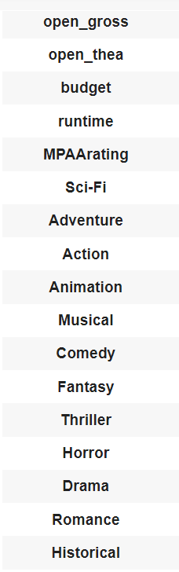
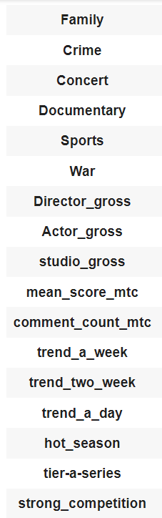
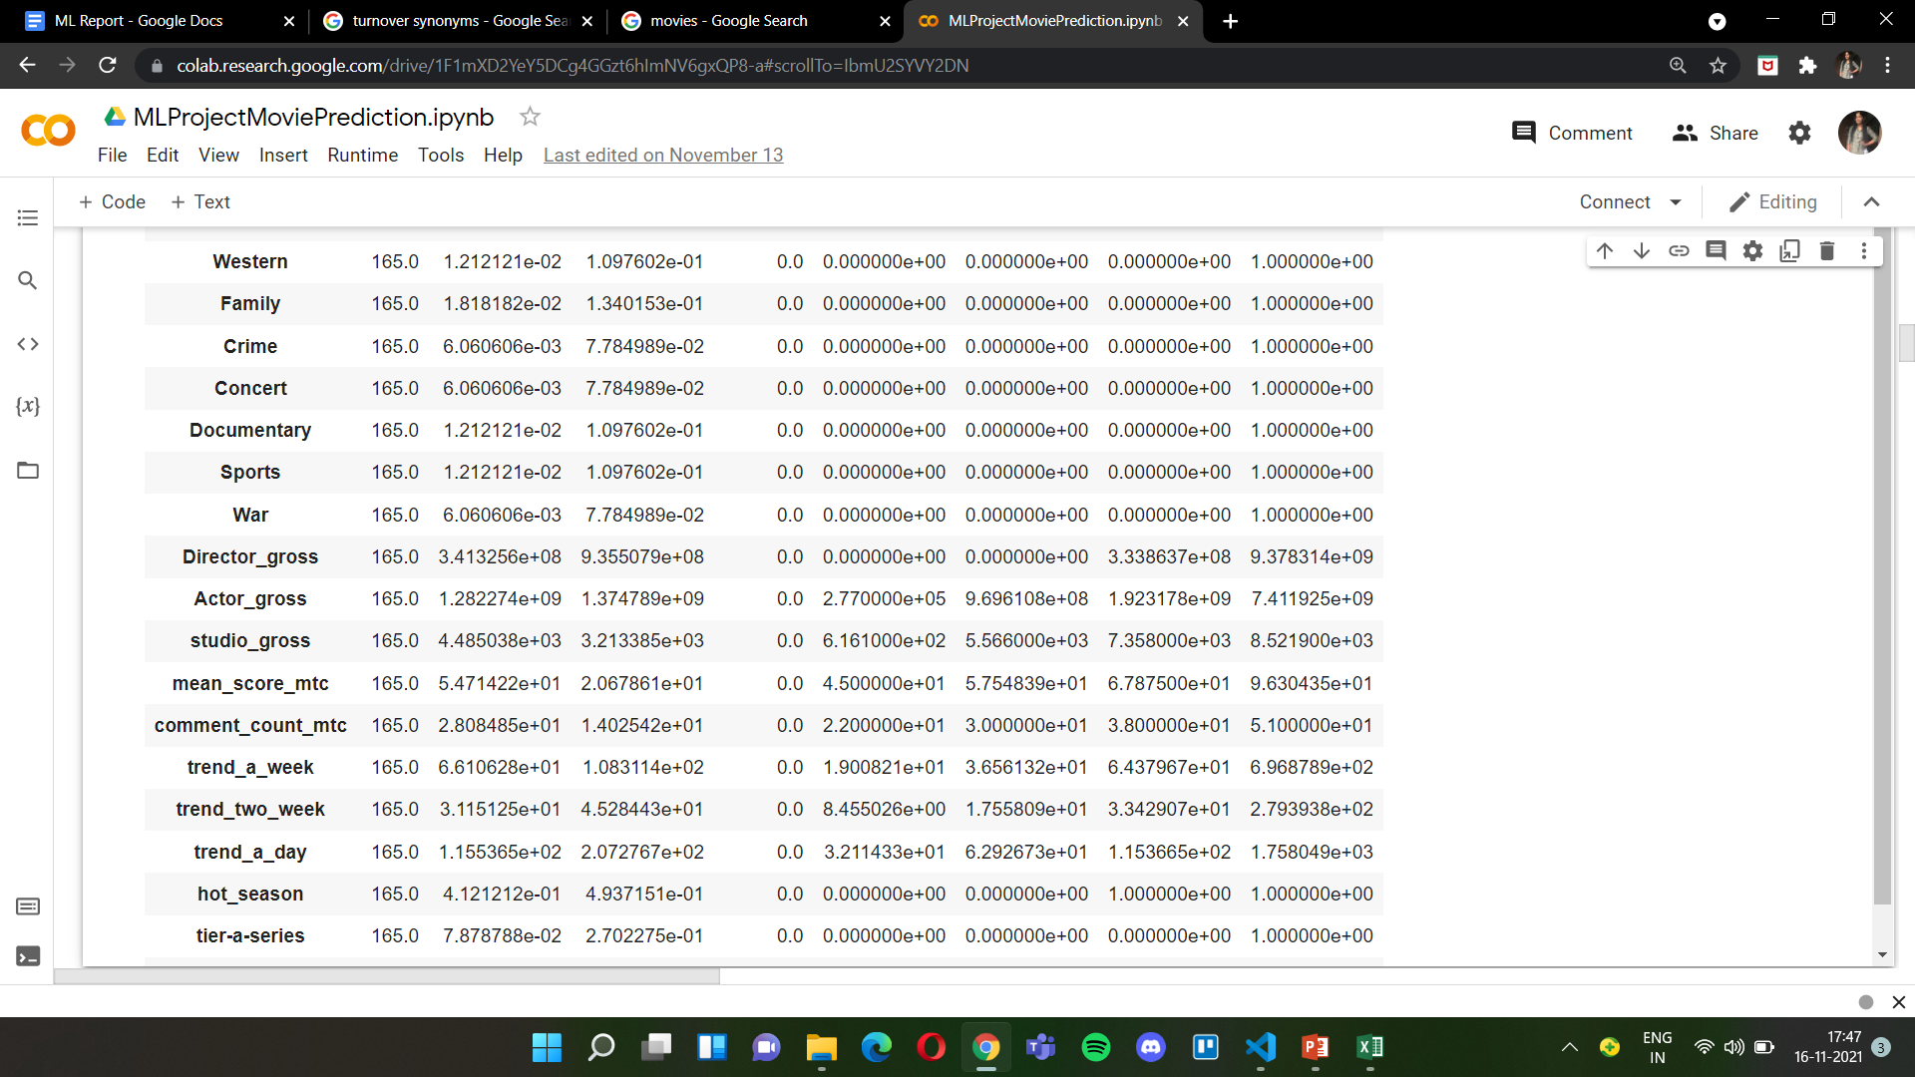
Introduction – Data Description
Dataset from DataWorld based on IMDB, Box Office Mojo, Metacritic and Google Trends.
35 total features
30 input features
1 target feature
Binary Features: Sci-Fi, Adventure, Action, Animation, Musical, Comedy, Fantasy, Thriller, Horror, Drama, Romance, Historical. Western, Family, Crime, Concert, Documentary, Sports, War, MPAArating.
Continuous Features: budget, runtime, open_gross, ope_thea, Actor gross, Director gross, studio gross, mean score mtc,
Numeric Features: comment count mtc, trendaday, trendaweek.
Notes:
36 features

Slide 5
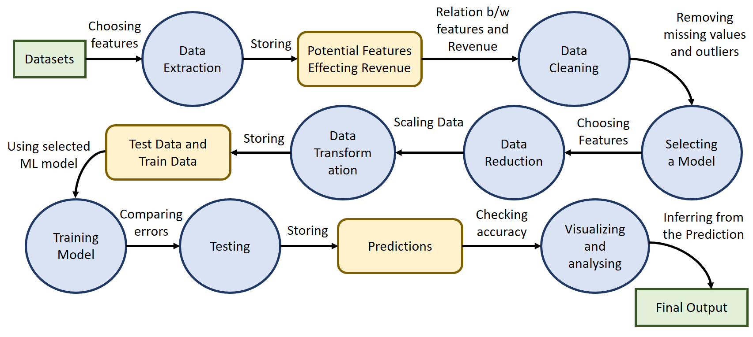
Technique Description – Data Flow Diagram

Slide 6
Technique Description – Algorithms Used
Data Preprocessing
Relation between features
Pair plot, Box plot, Correlation matrix
Data Cleaning
Model Selection
Huber, Lasso, Elastic Net, Ridge, SVM, KNN, MLP
Data Reduction
Forward Feature Selection, Backward Feature Reduction, Principle Component Analysis
Data Transformation
Normalization, Min-Max
Model Training and Testing
Results and Conclusion
Accuracy score, R square error, Mean Absolute Error

Slide 7
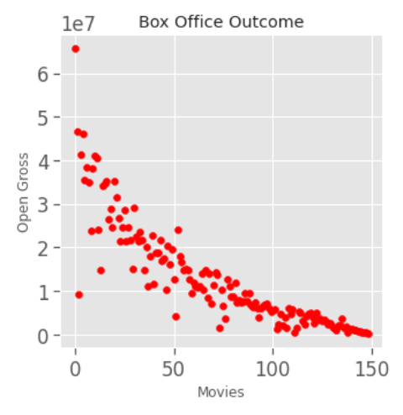
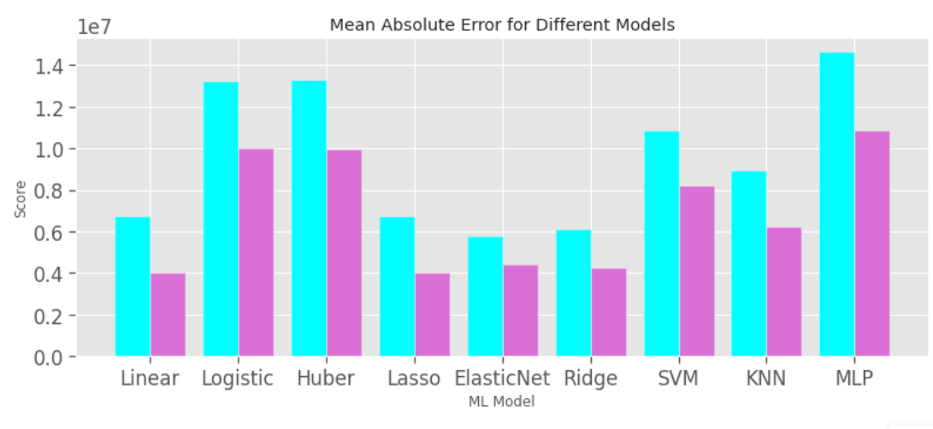
Results & Discussion - Outcome

Slide 8
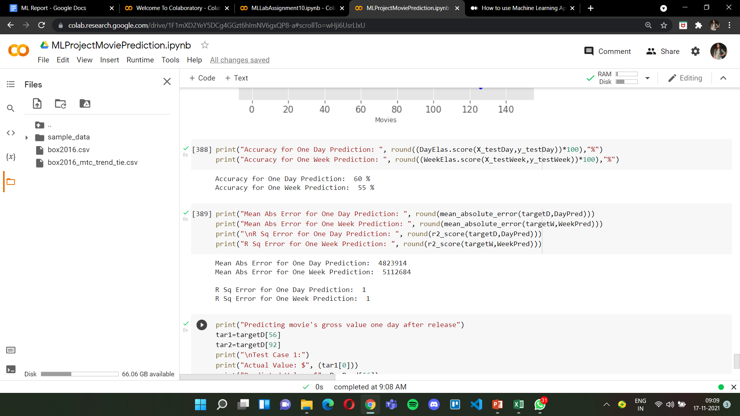

Results & Discussion - Inference
Smaller dataset (165 x 35)
Impute missing values approximately
Success of a movie is relative and not based purely on its turnover

Slide 9
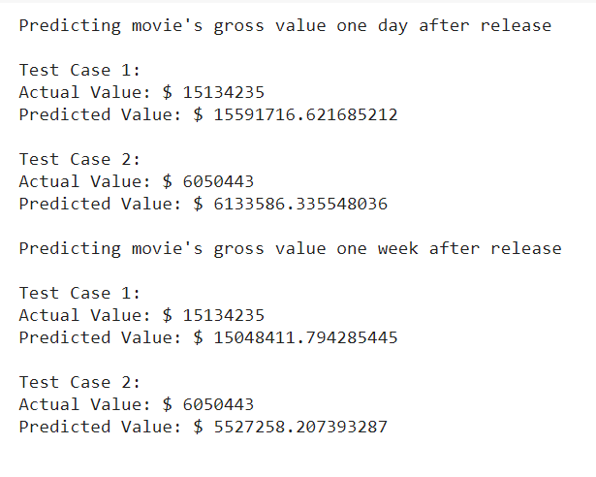
Results & Discussion - Interpretation
This prediction is accurate enough to interpret:
Whether to release in more theatres.
Whether to release on OTT platforms.
Post opening marketing strategies.

Slide 10
Work Split-Up
Aashutosh G Vyas – BL.EN.U5CSE19002
Model Selection, Accuracy Analysis for model selection
Gayatri S Sannala – BL.EN.U5CSE19045
Data Cleaning, Data Reduction, Result & Conclusion
K. V. G. Rohith – BL.EN.U5CSE19073
Data Preprocessing, Data Cleaning
Lavanya Shirisha M. – BL.EN.U5CSE19076
Data Visualizations, Model Selection, Result & Conclusion
Vinamratha Pattar - BL.EN.U5CSE19145
Data Transformation, Data Reduction analysis

Slide 11

Thank you !!!!!

